Slide 1
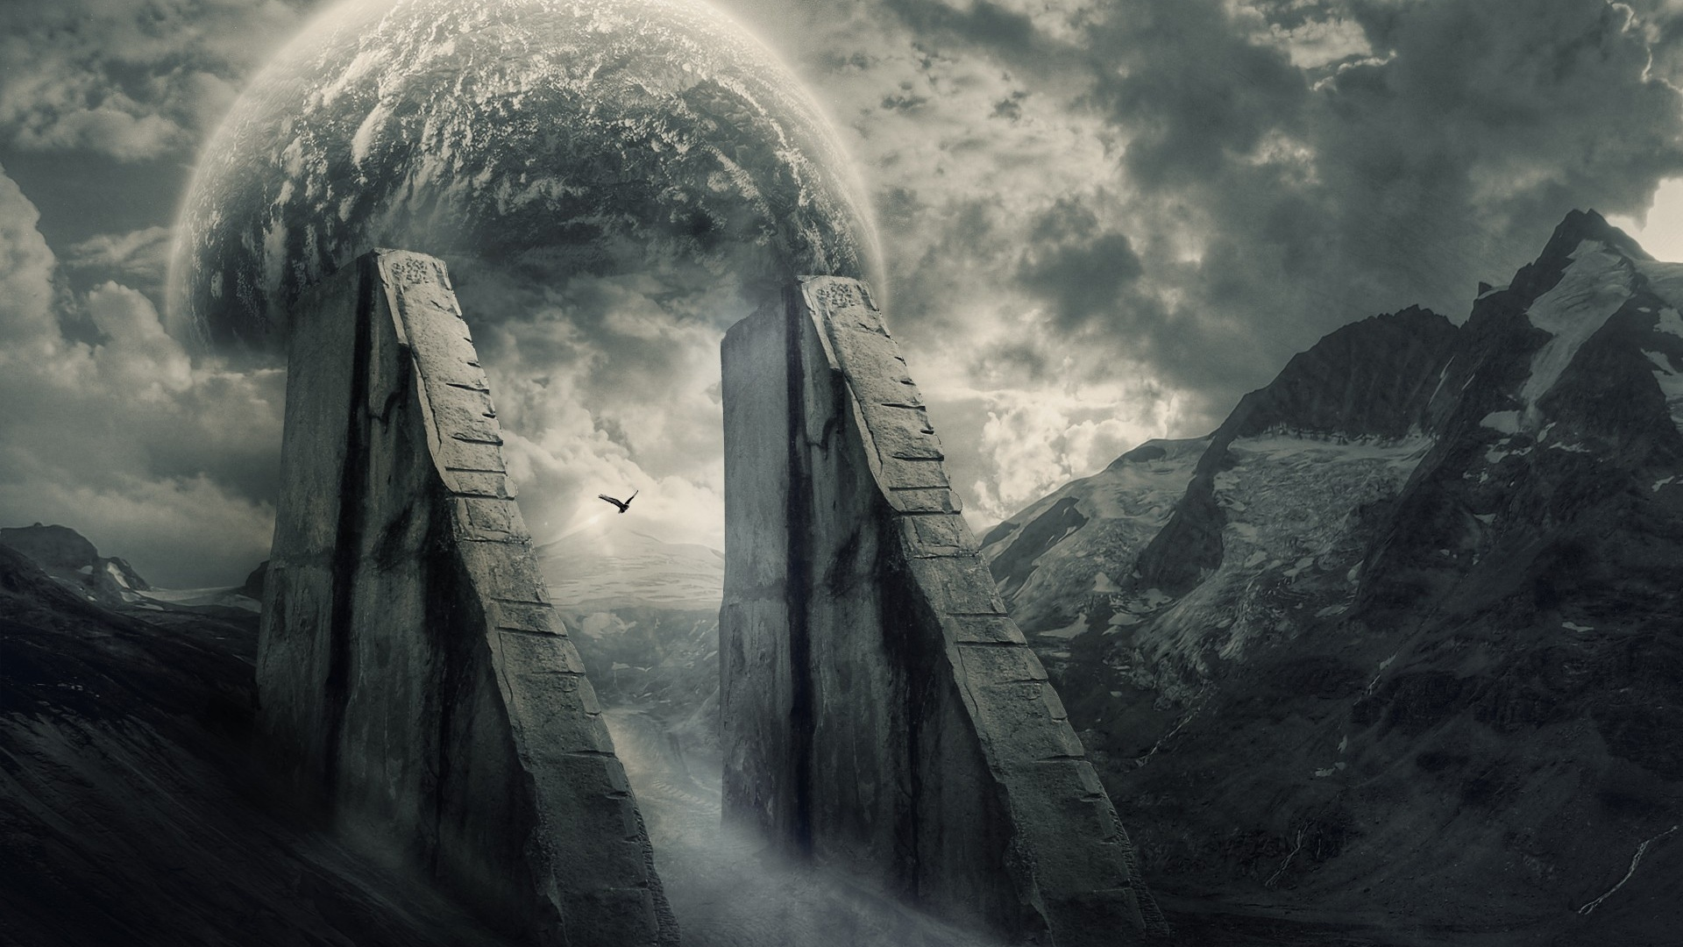
Blade of the Lost: The Silent Survivor Progress Report 2:
Developers: Josef Bacík (312553801) and Eduin Hernandez (艾德文 - 0860828)
Group #19
Instructor: 黃世強
https://wallpapersafari.com/w/Ppzkj5

Slide 2
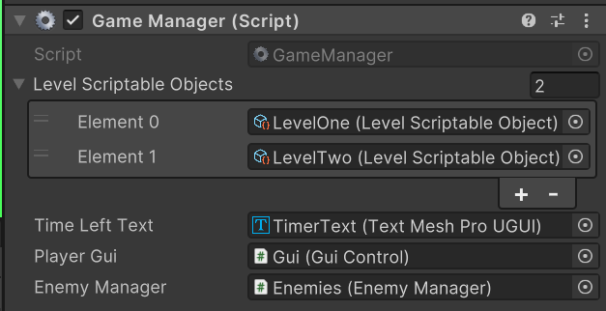
Wawe system
Game manager
Time based waves
Spawns enemies up to a limit
Each level has its own properties

Slide 3
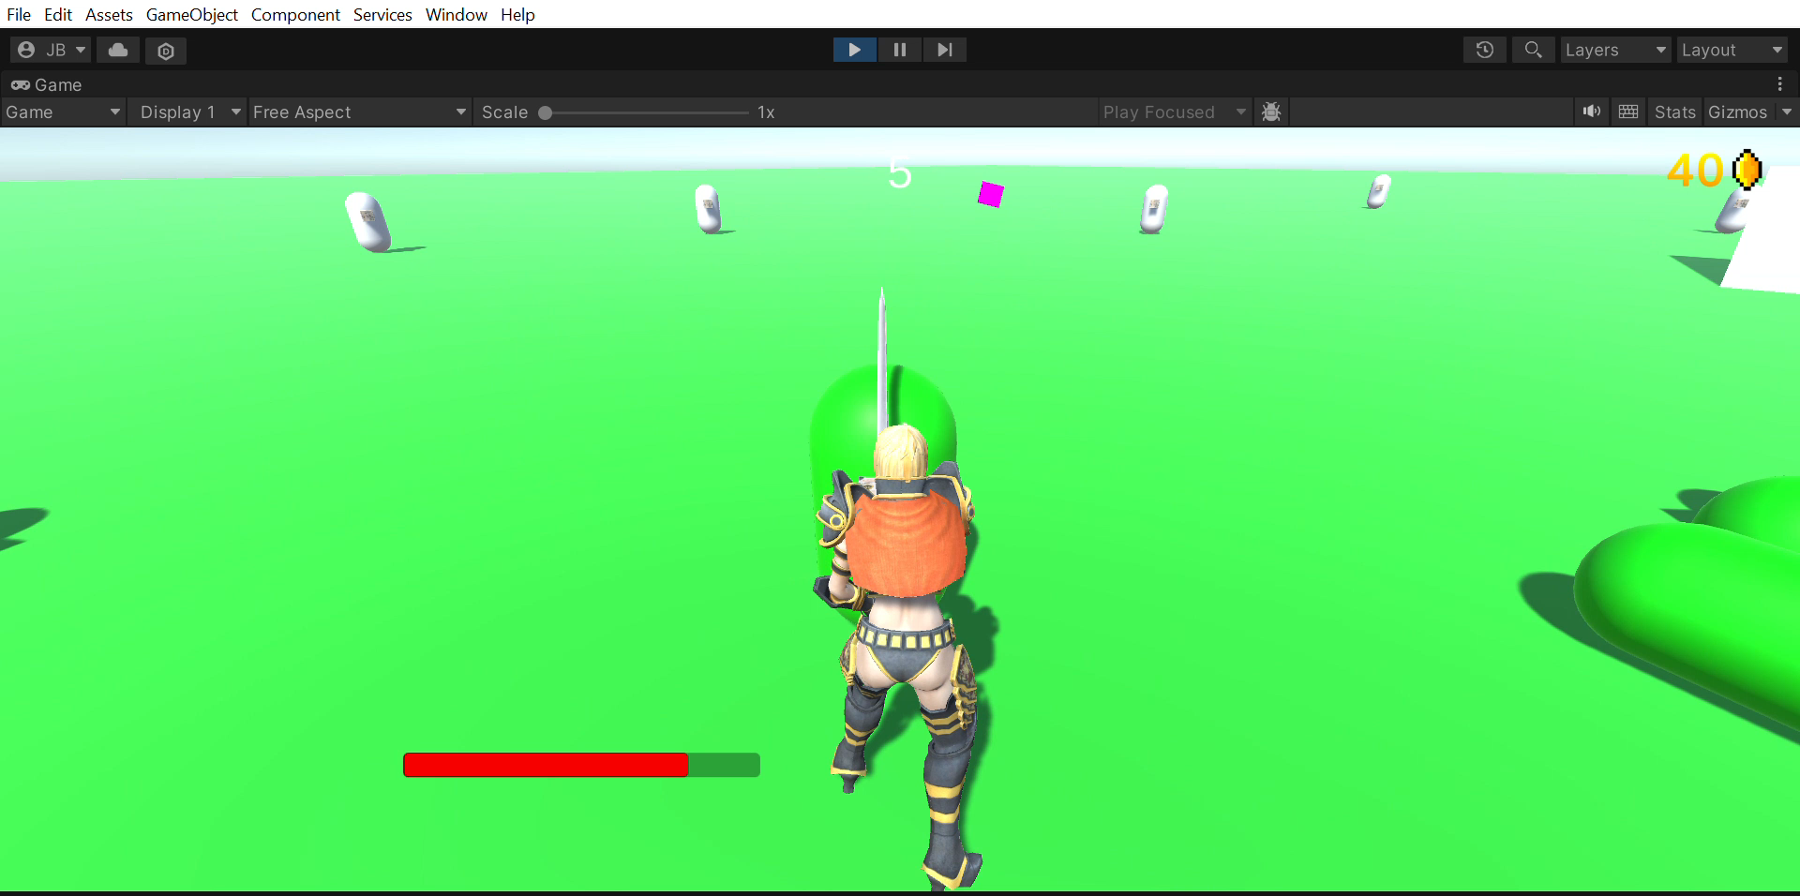
Wawe system

Slide 4
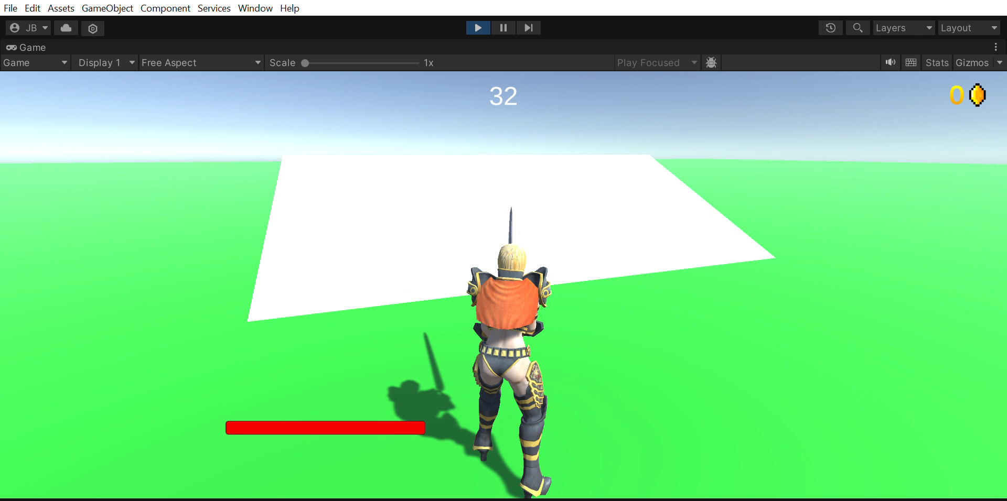
Better Camera
More expected camera manipulation
Scroll in and out
Maximum top and bottom view angle

Slide 5
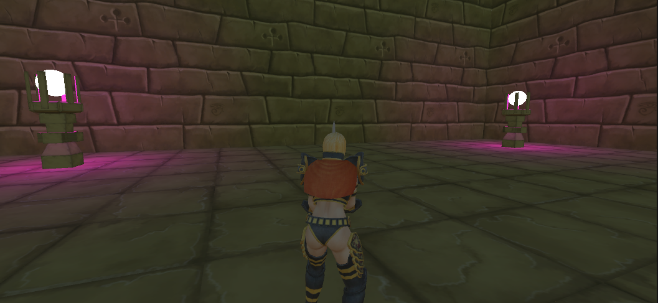
Arena design – Level 1?

Slide 6


Next steps
Add another enemy AI
Wave system
Finish arena(s)
Add more item variations and sprites
Enemy models
Enemy and player animations
Add more Player stats
Add Sounds

Slide 7
THANK YOU!

